Slide 1
Last week’s reading/watching (1-2 hours)
DJ: Watch: Research for the Newsroom playlist
MP: Read: Rothwell, J. Interview strategies in De Jong et al (2012) Creative Documentary: Theory and Practice (in Moodle folder on resources on interviewing
Optional listen: How to Book Engaging Podcast Interviews
Optional read: Blaine: The Digital Reporter’s Notebook
Optional watch: guest talk by Niamh McIntyre

Slide 2
Directed study review
Use a range of sources to identify potential interviewees for your story idea across all 4 categories. 20+ names total, at least an hour!
Identify any over-represented demographics and ways you might address that - to discuss next week
Make a shortlist of your top 5 - why are they top?
Be ready to discuss next week!

Slide 3

Planning great interviews
Paul Bradshaw | MED7334 Narrative

Slide 4
Directed study review
Reflections on the reading/watching - what was useful?
20+ interviewees - which aspects of PEER were hardest?
How did you choose the final five?

Slide 5
The assignment
You should now have an idea (and Plan B) for the assignment
And a list of potential interviewees
You should have read about storytelling techniques to use
Questions about the assignment?
Questions about your idea?

Slide 6
Where are we?
Pre-production
Production
Post-production
Idea generation (wk 2)
Story-led research (3)
Interview planning (4)
Filming/recording (tech sessions)
Interviewing (5)
Drafting (6)
Further research (3/7)
Editing (7)
Editing for the web (8)
Editing for social (9)

Slide 7
What should you be able to do?
Identify steps to take when planning an interview
Plan different types of interview
Identify and deal with ethical scenarios such as “copy approval”, anonymity and vulnerable sources

Slide 8
1. Asking the
right questions

Slide 9
What type of story are you planning?
Is it a human interest story? E.g. inspiring, tragic, comic
Is it a practical story? E.g. a guide, tips, advice, or how-to
Is it an ‘update’ on events? E.g. a news story/press release
Is it providing perspective/understanding? E.g. an explainer, case study, behind-the-scenes, etc.

Slide 10
What type of story are you planning?
Is it a human interest story? E.g. inspiring, tragic, comic
Is it a practical story? E.g. a guide, tips, advice, or how-to
Is it an ‘update’ on events? E.g. a news story/press release
Is it providing perspective/understanding? E.g. an explainer, case study, behind-the-scenes, etc.
Don’t say it’s all these things! Have a clear main focus.

Slide 11
Do it now: pitch your story
Remember the principles we’ve learned: be succinct, use a verb.
Why does the story matter? (e.g. topicality, audience, impact)
Keep practising communicating your story to others.

Slide 12
Do it now: brainstorm questions
Your group is planning an interview with the head of an animal charity. List questions for ONE of the following:
A practical story on ‘How to look after an abandoned pet’
A news report on ‘Steep rise in abandoned pets’
A feature on how she ‘took abandoned dogs into my home’
An explainer on ‘Why are people abandoning their pets?’

Slide 13
How do the lists differ?
For a practical story, focus questions on concrete advice
For an ‘update’, focus on facts: the 5W+H — and what happens next
For a human interest story, focus on events, details (colour) and emotion. Imagine the questions the audience would have
For perspective/understanding, questions often repeat ‘why’ and ‘how’

Slide 14
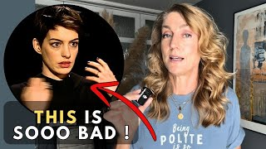
Open or closed questions?
Avoid closed questions to which the answer is yes or no - UNLESS you need a direct answer or evidence of avoidance.
Who/when/where questions can also generate limited answers: get that information through research before if you can.
Focus on open questions - especially how/why/what happened

Slide 15
Do you mean what you say?
Each question can be broken down into:
What you mean to say
What you actually say
What the person hears
What they think it means
+ When people can’t answer, they will answer a different question

Slide 16
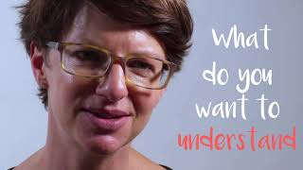
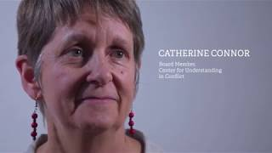
“What interview questions could challenge caricatures and diminish polarization?”
Solutions Journalism. 22 Questions that ‘Complicate the Narrative’, The Whole Story, February 11 2019, https://thewholestory.solutionsjournalism.org/22-questions-that-complicate-the-narrative-47f2649efa0e

Slide 17
22 INTERVIEW QUESTIONS TO COMPLICATE THE NARRATIVE
"What's dividing us on this issue?"
"How do you decide which information to trust?"
"What is oversimplified about this issue?"
"Where do you feel torn?"
"Is there any part of the [other side's] position that makes sense to you?"
"Why is this important to you?"
"Which experiences have shaped your views?"
"What do you want the other side to understand about you?"
"What do you want to understand about the other side?"
"How has this conflict affected your life?"
"What would change in your life if more people agreed with your stance?"
"What would it be like if people didn't agree with your stance?"
"Tell me more about that."
"How do you feel, telling this story?"
"Where does that (feeling, emotion, paranoia, distrust) come from?"
"Can I interrupt you? I want to make sure I have everything right."
"What's the question nobody's asking?"
"What do you think the other group thinks of you?"
"What do you think the other group wants?"

Slide 18
On- and off-record

Slide 19
From ‘on background’ to interview
Start with a chat, ‘on background’, rather than an interview
Easier to demonstrate why an interview might be needed:
“Could we interview you about that?”
“Would you be happy to go on camera/tape saying that?”
“Can I quote you on that?”
“Is there someone we could speak to about that?”

Slide 20
The pre-interview (but don’t call it that!)
Where interviews are recorded, it is common to call the person beforehand to ask them similar questions to those you are planning to record.
The objective is to identify how clear and engaging the interviewee is likely to be, and what they are likely to say (e.g. their position).
This informs planning…

Slide 21
Example strategies:
Risk | Strategy
Jargon | Explain to them beforehand who the audience is, and ask them to use plain language Be prepared to explain a piece of jargon in your role as interviewer
Talk too much/ Talk too little | Explain what is a good length for answers. Use body language to indicate you would like to ask a new question/them to expand.

Slide 22
2. Where and when
to interview

Slide 23
Do it now: brainstorm locations
List ideas for places you might do your interview with the head of an animal charity for those stories:
A practical story on ‘How to look after an abandoned pet’
A news report on ‘Steep rise in abandoned pets’
A feature on how she ‘took abandoned dogs into my home’
An explainer on ‘Why are people abandoning their pets?’

Slide 24
Setting — and behaviour
The setting of the interview is part of the story
Can you choose a setting that adds information?
Can you choose a setting that stimulates the interviewee?
Behaviour is communication — and part of the story
Can they demonstrate? Re-enact? React?

Slide 25
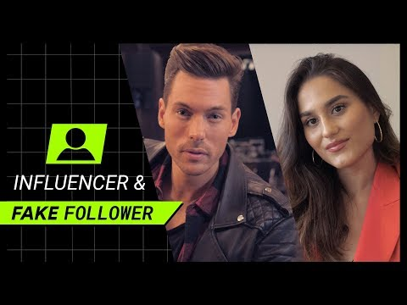
The interview is as much about behaviour as information: youtube.com/watch?v=K90QjwjSZXY&t=192s

Slide 26
Thinking in terms of interviewee ‘role’
Most stories ask people to describe what happened, explain why or how it happened, or what might happen — or to explain why it’s important.
The interviewee plays the role of an ‘authority’ on the event (as a participant), or a ‘critic’ of the event (as an expert) — but there are other options…

Slide 27
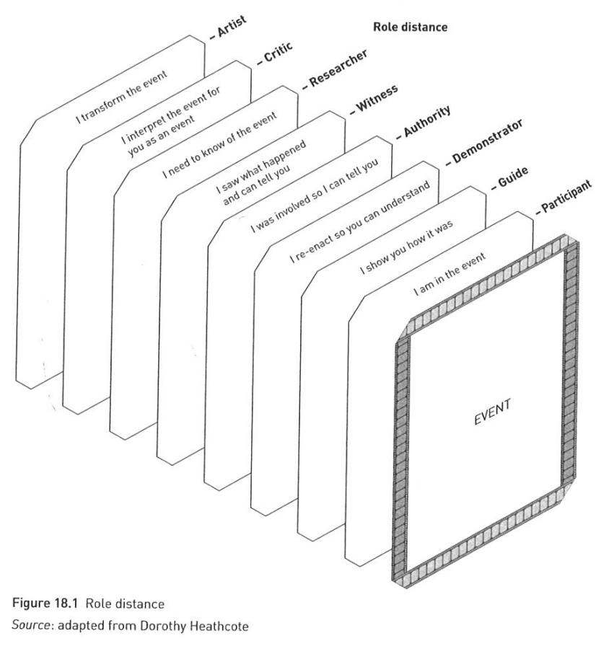
What ‘role’ can the person play
— and how close to the ‘event’?
Rothwell, J. Interview strategies in De Jong et al (2012) Creative Documentary: Theory and Practice

Slide 28
Example: why dealers buy graffiti
Events:
Finding graffiti
Buying art (auctions, galleries, artists)
Selling art
An interviewee doesn’t have to merely describe what happened, or explain it…

Slide 29
Interviewee’s ‘role’ in telling the story
Participant: talks as the event unfolds
Guide: walks through the event
Demonstrator: re-enacts the event later
Authority: on the event, as participant
Witness: to the event
Researcher: seeking truth
Critic: an authority/expert but who wasn’t involved personally

Slide 30
Interviewee’s ‘role’ in telling the story
Participant: talks as the event unfolds
Guide: walks through the event
Demonstrator: re-enacts the event later
Authority: on the event, as participant
Witness: to the event
Researcher: seeking truth
Critic: an authority/expert but who wasn’t involved personally

Slide 31
Example: interview options (buying art)
Participant: interview a buyer during an auction
Guide: interview a buyer as they walk through a gallery
Demonstrator: ask the buyer to re-enact preparations
Authority: interview a buyer after an auction
Witness: interview the buyer’s partner: “Were they excited?”
Researcher: interview a buyer as they try to find answers
Critic: interview an expert on graffiti art sales

Slide 32
Evidence this in the assignment
I brainstormed different ‘role distance’ (Rothwell 2012) options and chose to interview them as they worked.
Bibliography
Rothwell, J. Interview strategies in De Jong et al (2012) Creative Documentary: Theory and Practice

Slide 33
Do it now: identify interviewee roles
Participant: talks as the event unfolds
Guide: walks through the event
Demonstrator: re-enacts the event later
Authority: on the event, as participant
Witness: to the event
Researcher: seeking truth
Critic: an authority/expert but who wasn’t involved personally

Slide 34
Now: mid-module feedback time!
Do the mid-module feedback in this week’s section on Moodle
Then take a break!

Slide 35
3. Power and ethics

Slide 36
What do you do if…
You are related to/friends with/work with the source?
The interviewee wants to remain anonymous?
The interviewee wants to see your story before it’s live?
The interviewee says their contract stops them from talking to you?
The interviewee is under 18 or vulnerable in some way?

Slide 37
Who would you consider to be a “vulnerable” source?

Slide 38
Vulnerable sources
“Individuals or groups who may face significant risks or harm as a result of sharing information. These sources often come from marginalized communities or are involved in sensitive situations, making them more susceptible to negative repercussions, including legal action, social ostracism, or physical danger.”
https://library.fiveable.me/key-terms/investigative-reporting/vulnerable-sources

Slide 39
Characteristics of vulnerability
“International studies [identify] disability, post-trauma, mental illness, age and indigeneity* as characteristics signalling individuals as worth of special care.”
*indigeneity = indigenous, e.g. Aboriginal, Maori, Sioux
2010: https://ro.uow.edu.au/cgi/viewcontent.cgi?referer=&httpsredir=1&article=1248&context=creartspapers

Slide 40
BBC guidelines
“Contributors who are vulnerable or at risk of vulnerability may have particular needs according to their physical, emotional or mental state or personal or social circumstances at the time of their participation and afterwards. It is important to take advice both from professionals with the relevant expertise and from those responsible for their care, if appropriate.”

Slide 41
Speaking to vulnerable sources
Recognise the power imbalance
Take responsibility for describing the process
Give sources time to decide
Continually discuss how sources will be identified
Alert sources to the publication schedule (don’t go quiet)
https://www.poynter.org/commentary/2024/interviewing-vulnerable-voices-reporting/

Slide 42
“Should I interview this person?”
Make sure your source knows what to expect
Don’t mislead or confuse sources
Take a stance sometimes
Look for ways to give the source some editorial control
Use research and planning as tools of sensitivity
Address sources’ information gaps appropriately
When relevant, report on solutions
Follow up (after publication)
Give something back
Know what you and your outlet bring to the table (for better or worse)
Get ready to think big picture
Ask the hard questions
Reference: Yahr, Natalie. Why Should I Tell You?: A Guide to Less-Extractive Reporting, Center for Journalism Ethics, no date, https://ethics.journalism.wisc.edu/why-should-i-tell-you-a-guide-to-less-extractive-reporting

Slide 43

International Journalism Festival. Their story or yours? How to practice less extractive journalism, International Journalism Festival, April 20 2024, https://www.youtube.com/watch?v=6B2E9a21P5A

Slide 44
Should you give anonymity?
Arguments for granting anonymity:
Person is vulnerable and may be targeted unfairly
Arguments against:
Credibility/strength of story undermined (seeing is believing)
False claims can be made without accountability

Slide 45
Granting anonymity: practical concerns
Do you quote the source at all? Or use ‘on background’?
What other sources can provide the same information? Ask.
Does the information reveal their identity?
AI: can ‘masking’ technology be reversed?
Can they be connected to you through digital trails?
Duty of care post-publication

Slide 46
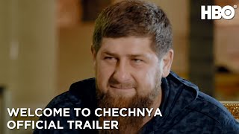
How ‘Welcome to Chechnya’ used A.I. and machine learning techniques to mask the doco’s subjects

Slide 47
“Can I see it before it’s published?”
Also known as ‘copy approval’
An ethical issue: compromises editorial independence (is your duty to the audience, or to the subject?)
A practical challenge: adds extra work/time
Standard answer: “I’m happy to check quotes/facts, but I’m sure you understand I can’t share the finished story”
Why are they asking? Address that…

Slide 48
Addressing wariness/mistrust
Ask if they have any concerns about the interview, rather than waiting for them to act on those
Help them to understand your role: to serve an audience/tell a story accurately and fairly. Not “just a story”
Misrepresentation: you can check quotes
Factual inaccuracy: you can check facts
Offer not to include them in the story

Slide 49
“Can I see the questions beforehand?”
Sending questions in advance can make for better answers, especially around expertise or experience
Manage expectations: “Here are the questions planned - obviously I might have other questions on the day”
If you want an element of surprise, send some questions but not those where you want genuine reaction

Slide 50
Do it now: act out the scenario
The charity boss asks if they can see the story before it goes live
What do you say?

Slide 51
Conflicts of interest
Avoid interviewing people you know, if you can
If you have to, be transparent: “declare” your interest
Look at guidelines on conflicts of interest in your field
Identify potential risks, and how to address those, e.g.
Imagine what a critical person would ask
Ensure an independent professional edits/checks plans/work

Slide 52
Planning for
cognitive biases

Slide 53
What are cognitive biases?
Mental shortcuts that we use to make decisions.
Confirmation bias is the best-known. Others include hindsight bias (relevant when asking people about past events) and the halo effect (we think someone with a good quality is a good person).

Slide 54
A genAI prompt for cognitive bias:
You are an experienced editor who previously trained in psychology. You have a deep understanding of cognitive biases and always look to identify cognitive bias in stories that you edit. A reporter asks you for advice on interviewing [DESCRIBE INTERVIEWEE]. What advice would you give on planning the questions. (see some answers)

Slide 55
Assignment: next steps
Decide on an idea if you haven’t already
Identify enough potential interviewees for that idea to account for 90% failure rate
Use the techniques from the lectures and readings
Allocate time in your diary for specific stages of the process

Slide 56
Key points
Plan questions based on the type of story (practical, human interest, understanding or update)
Consider the role your interviewee(s) play — or could play — in the story
Identify ethical issues and considerations around issues like anonymity and copy approval

Slide 57
Directed reading
Choose a reading from the folder on interviewing

Slide 58
Directed study task
Make approaches to the five names on your interviewee list
(Ask for a chat first, before a full interview)
Brainstorm the questions you will ask
THEN draw up a shortlist of the ones best for your story
Share it with me!

